Slide 1
Patlak plot
Oct 5, 2023
Zeyu Zhou
MIRA Group Meeting Review

Slide 2
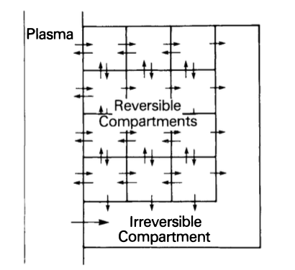







$$C=C_{1}+C_{2}$$
$$K_{1}$$
$$k_{3}$$
e.g. [18F]FDG
$$C_{P}$$
$$C_{1}$$
$$C_{2}$$
$$k_{2}$$
The original general model considered by Patlak et. al (1983)
For illustration in this review

Slide 3

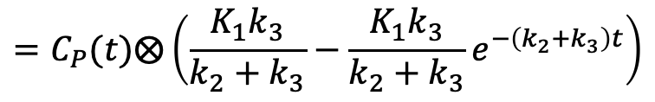


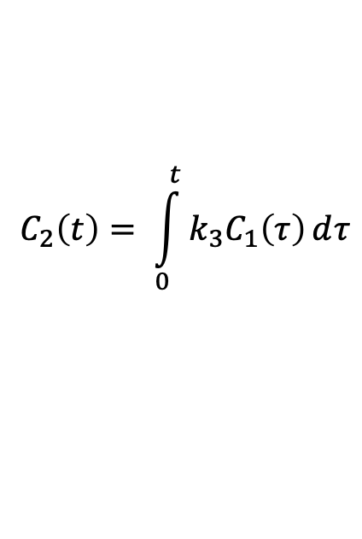


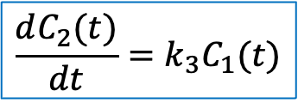

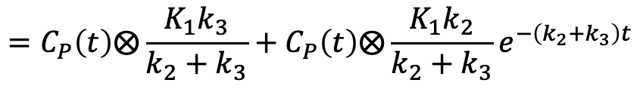


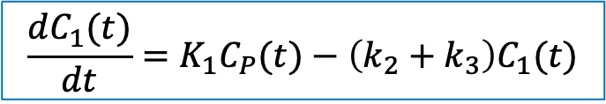
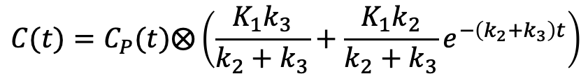
$$C=C_{1}+C_{2}$$
$$\frac{dC_{1}(t)}{dt}=K_{1}C_{P}(t)−\left(k_{2}+k_{3}\right)C_{1}(t)$$
$$C_{1}\left(t\right)=C_{P}(t)⨂K_{1}e^{−\left(k_{2}+k_{3}\right)t}$$
$$K_{1}$$
$$k_{3}$$
$$C_{P}$$
$$C_{1}$$
$$C_{2}$$
$$\frac{dC_{2}(t)}{dt}=k_{3}C_{1}(t)$$
$$k_{2}$$
$$C_{2}\left(t\right)= \int_{0}^{t}{k_{3}C_{1}\left(τ\right)ⅆτ}$$
$$=C_{P}(t)⨂\left(\frac{K_{1}k_{3}}{k_{2}+k_{3}}−\frac{K_{1}k_{3}}{k_{2}+k_{3}}e^{−\left(k_{2}+k_{3}\right)t}\right)$$
$$C(t)=C_{P}(t)⨂\left(\frac{K_{1}k_{3}}{k_{2}+k_{3}}+\frac{K_{1}k_{2}}{k_{2}+k_{3}}e^{−\left(k_{2}+k_{3}\right)t}\right)$$
$$=C_{P}\left(t\right)⨂\frac{K_{1}k_{3}}{k_{2}+k_{3}}+C_{P}\left(t\right)⨂\frac{K_{1}k_{2}}{k_{2}+k_{3}}e^{−\left(k_{2}+k_{3}\right)t}$$

Slide 4
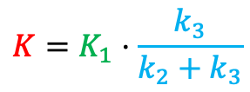
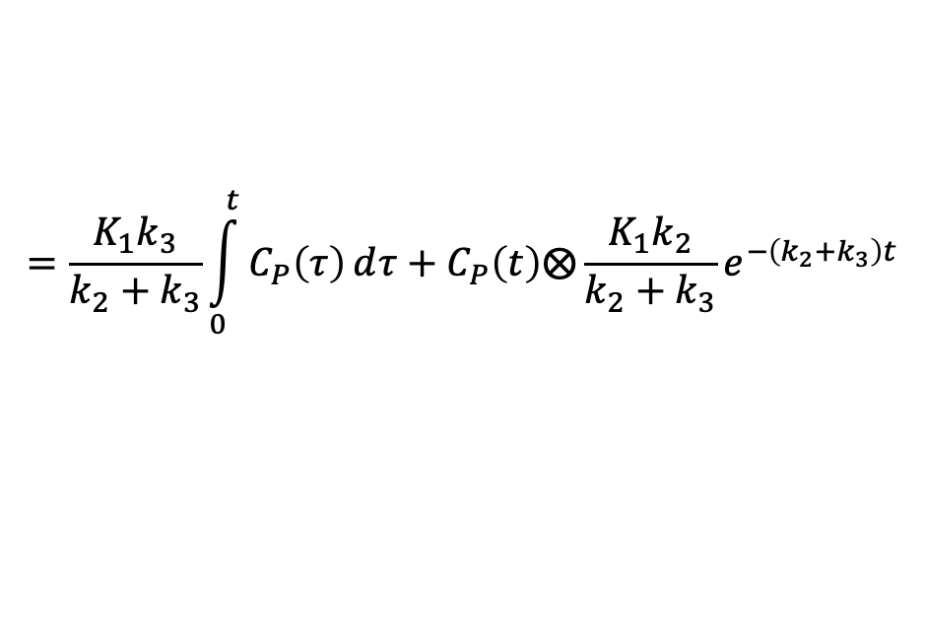
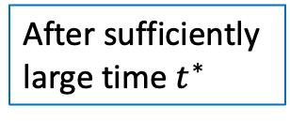
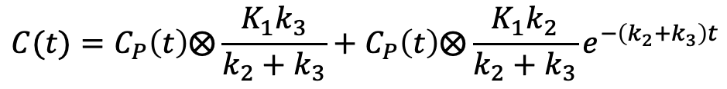
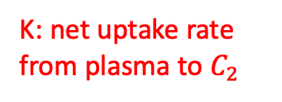
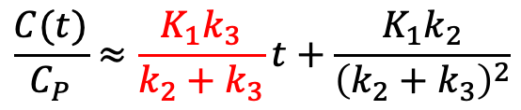
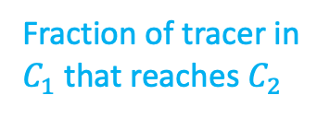
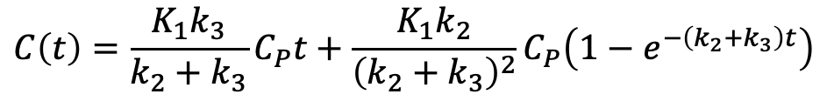

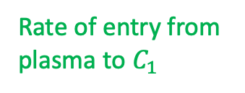
$$C(t)=C_{P}\left(t\right)⨂\frac{K_{1}k_{3}}{k_{2}+k_{3}}+C_{P}\left(t\right)⨂\frac{K_{1}k_{2}}{k_{2}+k_{3}}e^{−\left(k_{2}+k_{3}\right)t}$$
$$C=C_{1}+C_{2}$$
$$=\frac{K_{1}k_{3}}{k_{2}+k_{3}}\int_{0}^{t}{C_{P}\left(τ\right)ⅆτ}+C_{P}\left(t\right)⨂\frac{K_{1}k_{2}}{k_{2}+k_{3}}e^{−\left(k_{2}+k_{3}\right)t}$$
$$K_{1}$$
$$k_{3}$$
$$C_{P}$$
$$C_{1}$$
$$C_{2}$$
If $C_{P}(t)$ is a constant over time
$$k_{2}$$
$$C\left(t\right)=\frac{K_{1}k_{3}}{k_{2}+k_{3}}C_{P}t+\frac{K_{1}k_{2}}{{\left(k_{2}+k_{3}\right)}^{2}}C_{P}\left(1−e^{−\left(k_{2}+k_{3}\right)t}\right)$$
After sufficiently large time $t^{∗}$
$$\frac{C(t)}{C_{P}}≈\frac{K_{1}k_{3}}{k_{2}+k_{3}}t+\frac{K_{1}k_{2}}{{\left(k_{2}+k_{3}\right)}^{2}}$$
$$K=K_{1}⋅\frac{k_{3}}{k_{2}+k_{3}}$$
Rate of entry from plasma to $C_{1}$
Fraction of tracer in $C_{1}$ that reaches $C_{2}$
K: net uptake rate from plasma to $C_{2}$

Slide 5
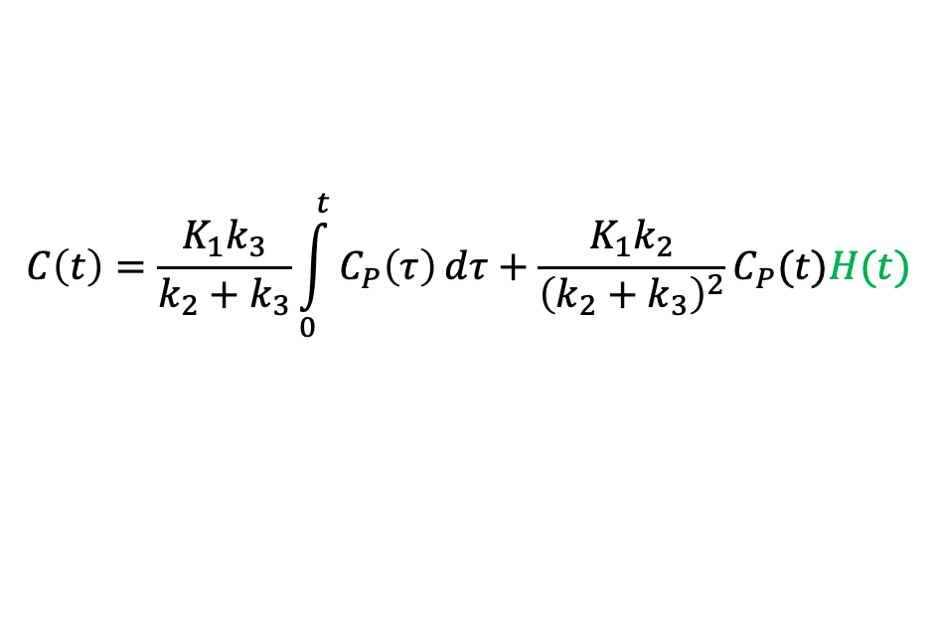
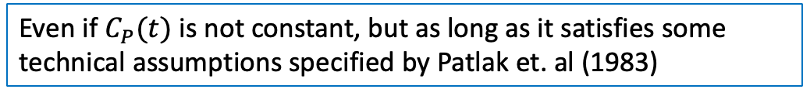
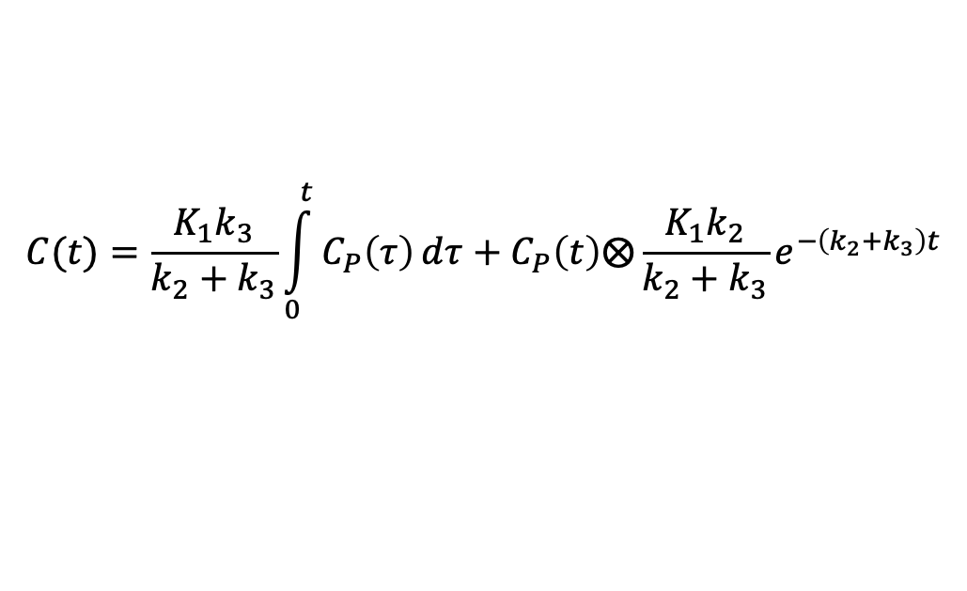
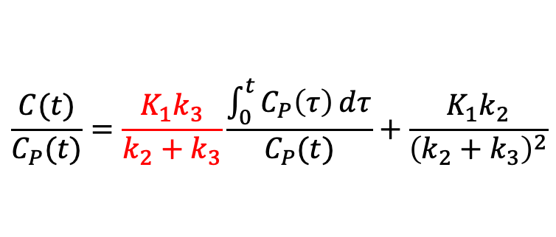
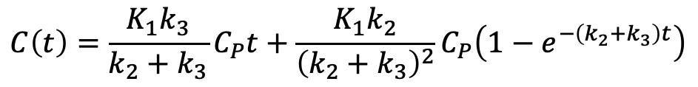


$$C=C_{1}+C_{2}$$
$$C(t)=\frac{K_{1}k_{3}}{k_{2}+k_{3}}\int_{0}^{t}{C_{P}\left(τ\right)ⅆτ}+C_{P}\left(t\right)⨂\frac{K_{1}k_{2}}{k_{2}+k_{3}}e^{−\left(k_{2}+k_{3}\right)t}$$
$$K_{1}$$
$$k_{3}$$
If $C_{P}(t)$ is a constant over time
$$C_{P}$$
$$C_{1}$$
$$C_{2}$$
$$k_{2}$$
$$C\left(t\right)=\frac{K_{1}k_{3}}{k_{2}+k_{3}}C_{P}t+\frac{K_{1}k_{2}}{{\left(k_{2}+k_{3}\right)}^{2}}C_{P}\left(1−e^{−\left(k_{2}+k_{3}\right)t}\right)$$
Even if $C_{P}(t)$ is not constant, but as long as it satisfies some technical assumptions specified by Patlak et. al (1983)
$$C\left(t\right)=\frac{K_{1}k_{3}}{k_{2}+k_{3}}\int_{0}^{t}{C_{P}\left(τ\right)ⅆτ}+\frac{K_{1}k_{2}}{{\left(k_{2}+k_{3}\right)}^{2}}C_{P}(t)H(t)$$
$$H\left(t\right)→1 as t→∞$$
$$\frac{C(t)}{C_{P}(t)}=\frac{K_{1}k_{3}}{k_{2}+k_{3}}\frac{\int_{0}^{t}{C_{P}\left(τ\right)ⅆτ}}{C_{P}(t)}+\frac{K_{1}k_{2}}{{\left(k_{2}+k_{3}\right)}^{2}}$$
Y axis
X axis: scaled time

